Slide 1
Week 1
Introduction to Data

Slide 2
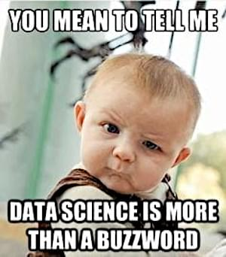
What is data
Data is facts
Data is values
Data can be collected

Slide 3
What is information
Information is what we can get out of the data
If data is a fact, information tells us why that fact is important
Data: The sky is Blue
Information: Blue skies indicate clear weather and unlikely to rain
If data is a value, information is what we can do with that value
Data: Temp is 90°
Information: Not a good day to wear a sweater
If data is collected, information is what we can use the collection for

Slide 4
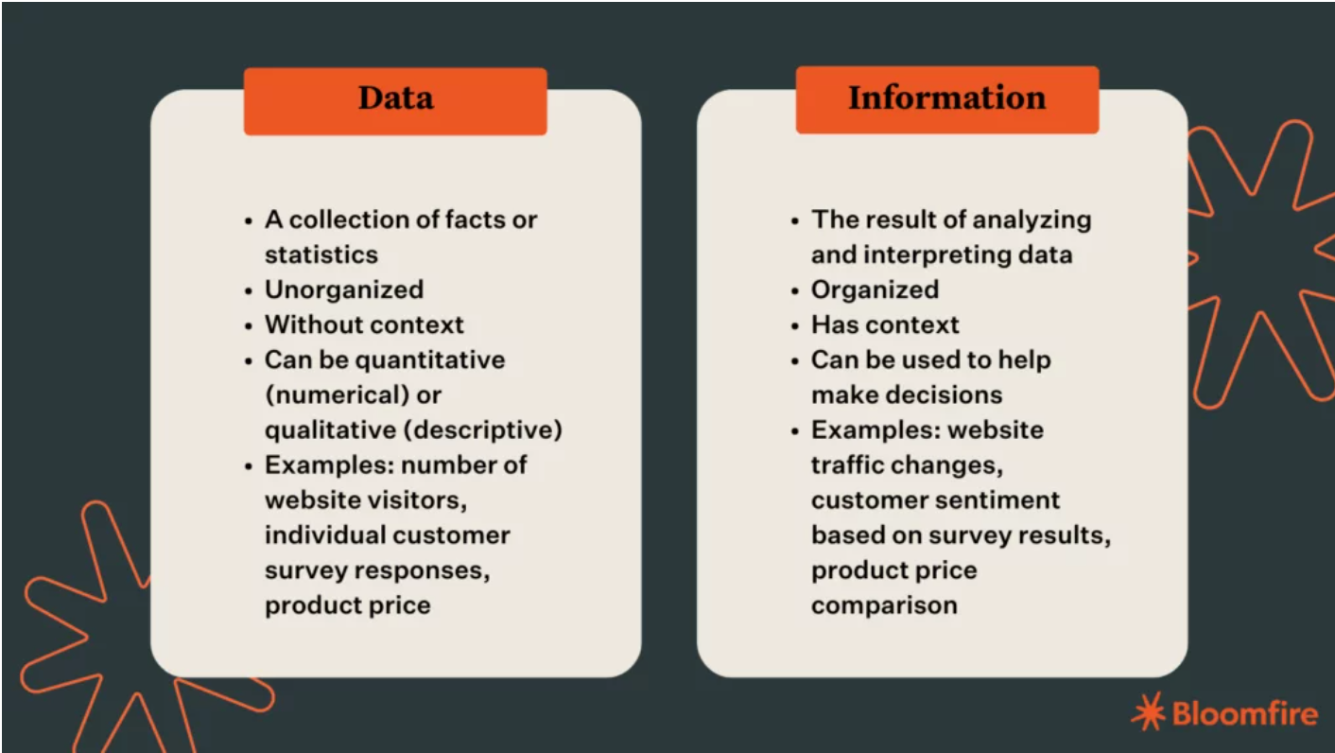
Data vs Information
https://bloomfire.com/blog/data-vs-information/

Slide 5
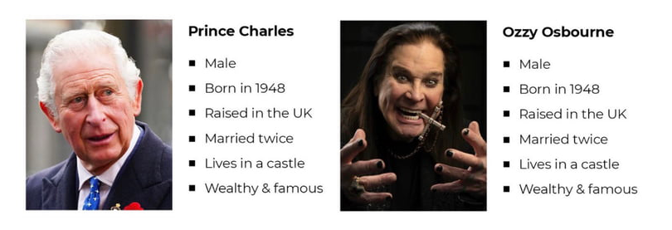
Why data and information are important to everyone
Data helps us make choices
Shopping in a grocery store you can see prices (Data) and this can help you figure out if you're going over budget and what you can make for the week (information)

Slide 6
How different jobs use data and information
Sales might see numbers go up or down and that can help them decide on the next ad campaign with marketing, or where those ad dollars could be better spent (YouTube vs Cable vs Popup ads)
Payroll might see how much money is coming into a company vs going out and give that to management to see if they can hire new employees
Food prep and kitchen staff might see increases in food waste on certain days and decide to redo ordering or prep to make better use of resources
Investors might see market trends go up or down and change where they are putting their money

Slide 7
Example: Data collected to make business decisions
Business tracks money coming in through sales
Demand for electric cars going up
Marketing tracks numbers of views on ads to see what's getting the most attention
YouTube stars and Podcasts are getting discount coupons that are being heavily used in preorders
Payroll tracks money going out through expenditures and salaries
R&D is through the roof to design better batteries to make travel longer distances possible
Management tracks productivity of their teams to see what is being produced
People are working hard to meet the goal of redesigned cars/batteries/self-driving
All that information is presented to C-Suite people to make choices about which direction the company is going to go into
It's a good time to go into electric car production, let's move the company towards 30% electric from the 10% we were last year

Slide 8
Example: Book data and libraries
Libraries track books coming in and out
Libraries track how many people go in and out of the building every day and weekly/monthly/yearly trends
Libraries track Book titles, Authors, ISBN numbers to see what's likely to be popular in their area
Libraries track how many and who comes to their events to see what they should have more/less of

